Slide 1
LFAB Vendor Safety Meeting
11/26/2024

Slide 2
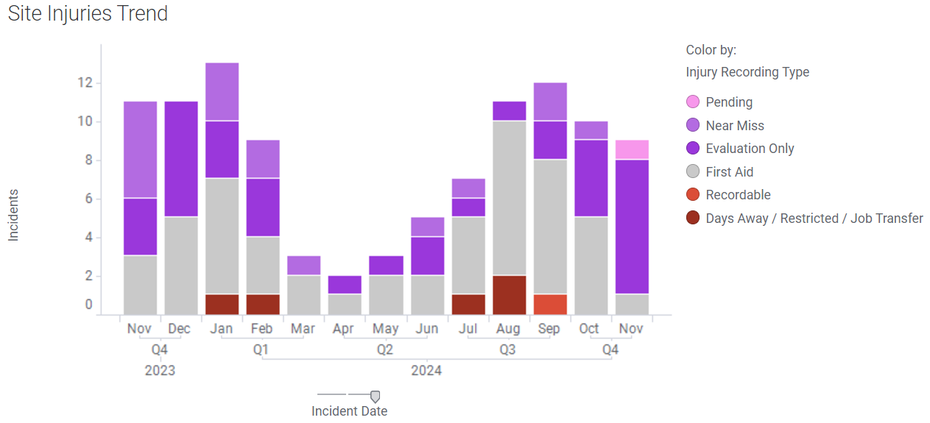
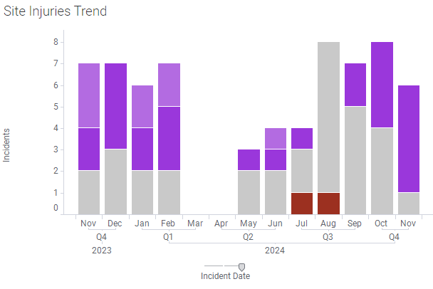
LFAB Injury Metrics WW48
Contract Employees
Entire Site

Slide 3
LFAB Recent Events WW48
11.19.2024 - Desk shelf/drawer fell on foot
Lessons Learned: Situational Awareness
11.19.2024 - ESEW activation, possible chem exposure
Lessons Learned: Proper Response to exposure of unknown liquid
11.19.2024 - Debris in eye
Lessons Learned: Situational Awareness
11.21.2024 - Left wrist pain from repetitive motion
Lessons Learned: Ergonomics
11.21.2024 - Right wrist abrasion
Lessons Learned - Situational Awareness

Slide 4
LFAB Recent Events WW48
11.19.2024 - Desk shelf/drawer fell on foot
Affected Individual (AI) was sitting at desk and the under desk drawer fell onto AI’s foot.
Lessons Learned: Situational Awareness
Inspect all equipment for damage, degradation or malfunction prior to use.
11.19.2024 - ESEW activation, possible chem exposure
AI felt a drop of liquid on his back. AI’s partner verified that indeed, there was a drip. He then descended from the catwalk and entered an ESEW.
Lessons Learned: Proper Response to exposure of unknown liquid
11.19.2024 - Debris in eye
AI Working in the area reported an unknown object in eye. AI was using cutting equipment and was wearing safety glasses. AI was working with a fan blowing directly at the face. Suspected object in eye was dust from the fan blowing particulate around the workspace
Lessons Learned: Situational Awareness
Coach crew on performing work away from places where dust/debris can fall.
Remind employees to wear "spoggles" if there is a chance they will get debris in their eye.
11.21.2024 - Left wrist pain from repetitive motion
AI reported pain in wrist after repetitively move parts
Lessons Learned: Ergonomics
Report all ergonomic discomfort to ESH as soon as discomfort is noticed.
11.21.2024 - Right wrist abrasion
AI was moving a chemical drum. As he was pulling backwards to stage the drum, his foot slipped on plastic trash that was left on the floor. This caused the drum dolly to press his right wrist into nearby equipment causing a scrape and redness on the skin.
Lessons Learned - Situational Awareness
Clean workspaces reduce opportunities for injury

Slide 5
A Few Answers
Question #1:
Why do we call 801-767-7777 instead of 911?
Our site has 2.3 Million square feet of building space and more than 650 acres- Responders would never find caller location without an escort
Containment of the issue by local teams is more efficient due to system knowledge
Local teams will call public responders for assistance when needed. Escorts intercept local responders while in route and take them to appropriate location
Question #2:
If calling 7’s from a site phone, is there location ID transmitted with the call?
No- They are analogue phones

Slide 6
Pre Task Planning (Ricky Gettings/MEI)
Safety Document / JHA
- Interruptions to Facility / Damage to Facility
- Efficient
Sign, Grade and Execute Work Plan
- Ensure Crew Has a Complete Plan
- Improve the Quality
* Capture All Steps and Hazards
* Ensure Proper Mitigations
Read Out Loud to Crew
- By Author
- By Other
- Helps to Improve Communication

Slide 7
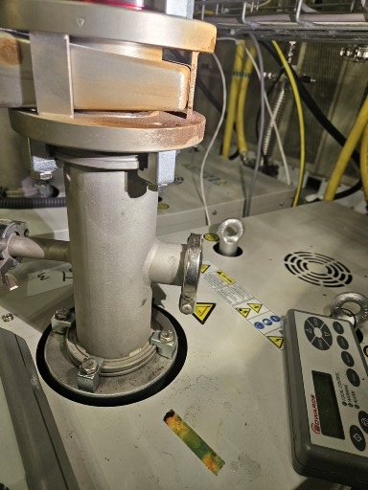
Shout-outs
Brown Discoloration
Jake England and James Glaubensklee (Wasatch Electric)
for reporting the leak on the pump for 88Y

